Slide 1
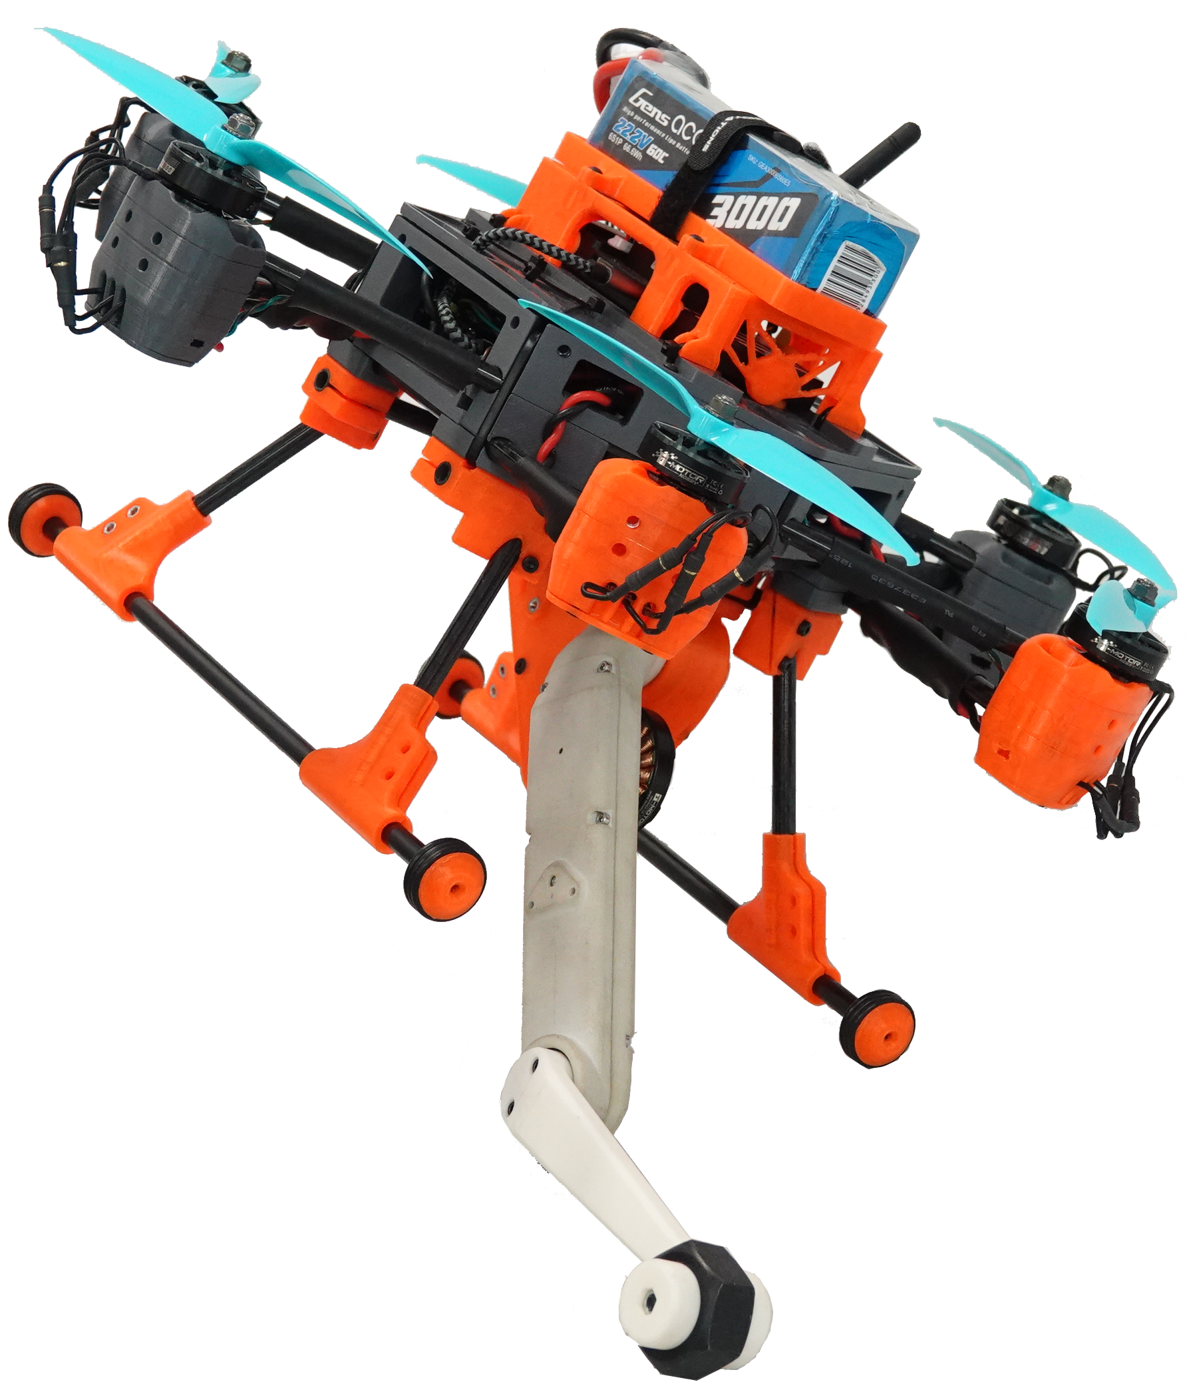
Borinot: an open thrust-torque-controlled robot for research on agile aerial-contact motion
Josep Martí-Saumell, Hugo Duarte, Patrick Grosch, Juan Andrade-Cetto, Angel Santamaria-Navarro, Joan Solà

Slide 2
Contents
Open-source
Agility
Hardware
Software
Control
Experiments

Slide 3
Open source ( Stéphane ? )
Benefitting from relevant OS initiatives
UAV
PX4
racing drones
Legged robots
ODRI
Solo, Bolt
Agile aerial loco-manipulation

Slide 4
Agile aerial-contact loco-manipulation

Slide 5
Agility
Robot conception guidelines
def: Ability to move quickly and easily
Maneuvers
Prediction
Small effort
Optimality
Under-actuated
Natural dynamics
Body with limbs
Redundant
Whole-body
Force-torque actuation
Contacts
Low inertia
High CoM
Compact, powerful, compliant, force-actuated robot
def: Ability of a complex body to combine quick maneuvers easily, using contacts and other forces against the environment
Whole-body dynamics optimal predictive control

Slide 6
Agility
Power, inertias and semantics
Soft motion
Energy-optimal
Low power-to-weight
Locomotion
Gentle motion
Graceful motion
Manipulation
Acrobatic motion
Aggressive motion
Time-optimal
High power-to-weight
Hybrid, loco-manipulation

Slide 7
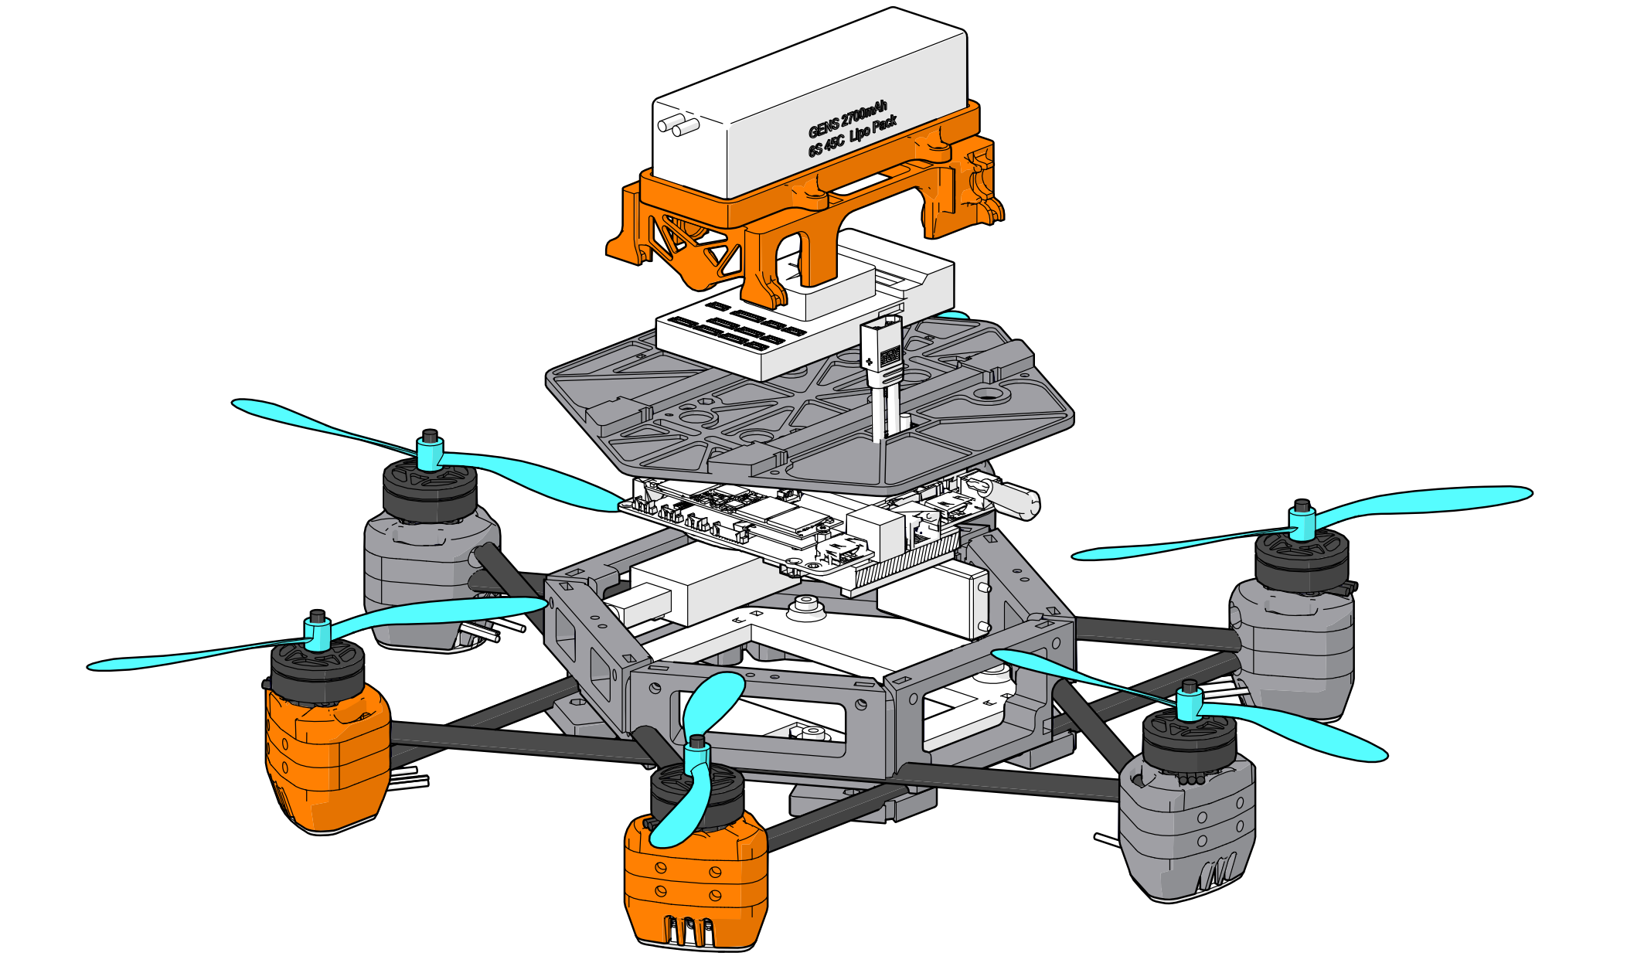
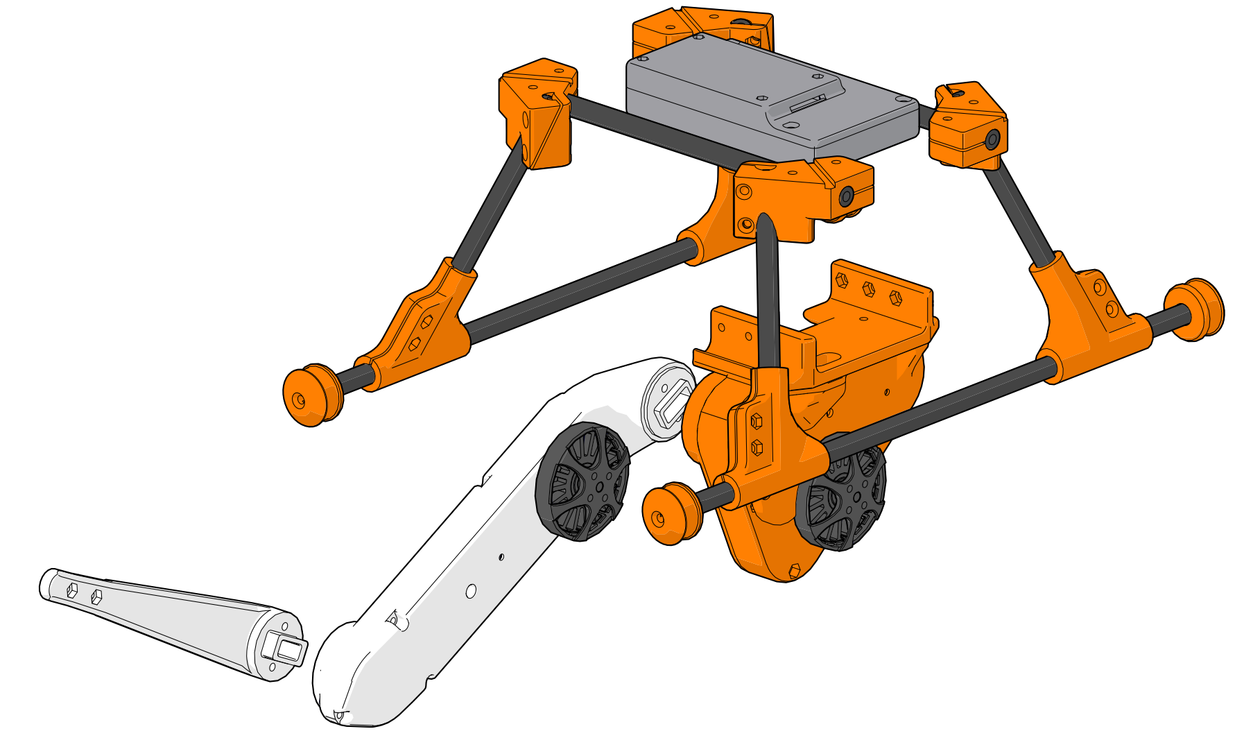
Borinot’s Hardware ( < 3.000€ )
Modular upper and lower bodies
Upper body
Lower body
Battery 6S 3Ah
Weight: 2100g Thrust: 100N TWR: 4,7
Weight: 742g Torque: 2,7Nm TWR: 3,5
ODRI controller
PixHawk5
NUC i7
RC receiver
Landing gear
Motor-propeller
Solo limb 2DoF

Slide 8
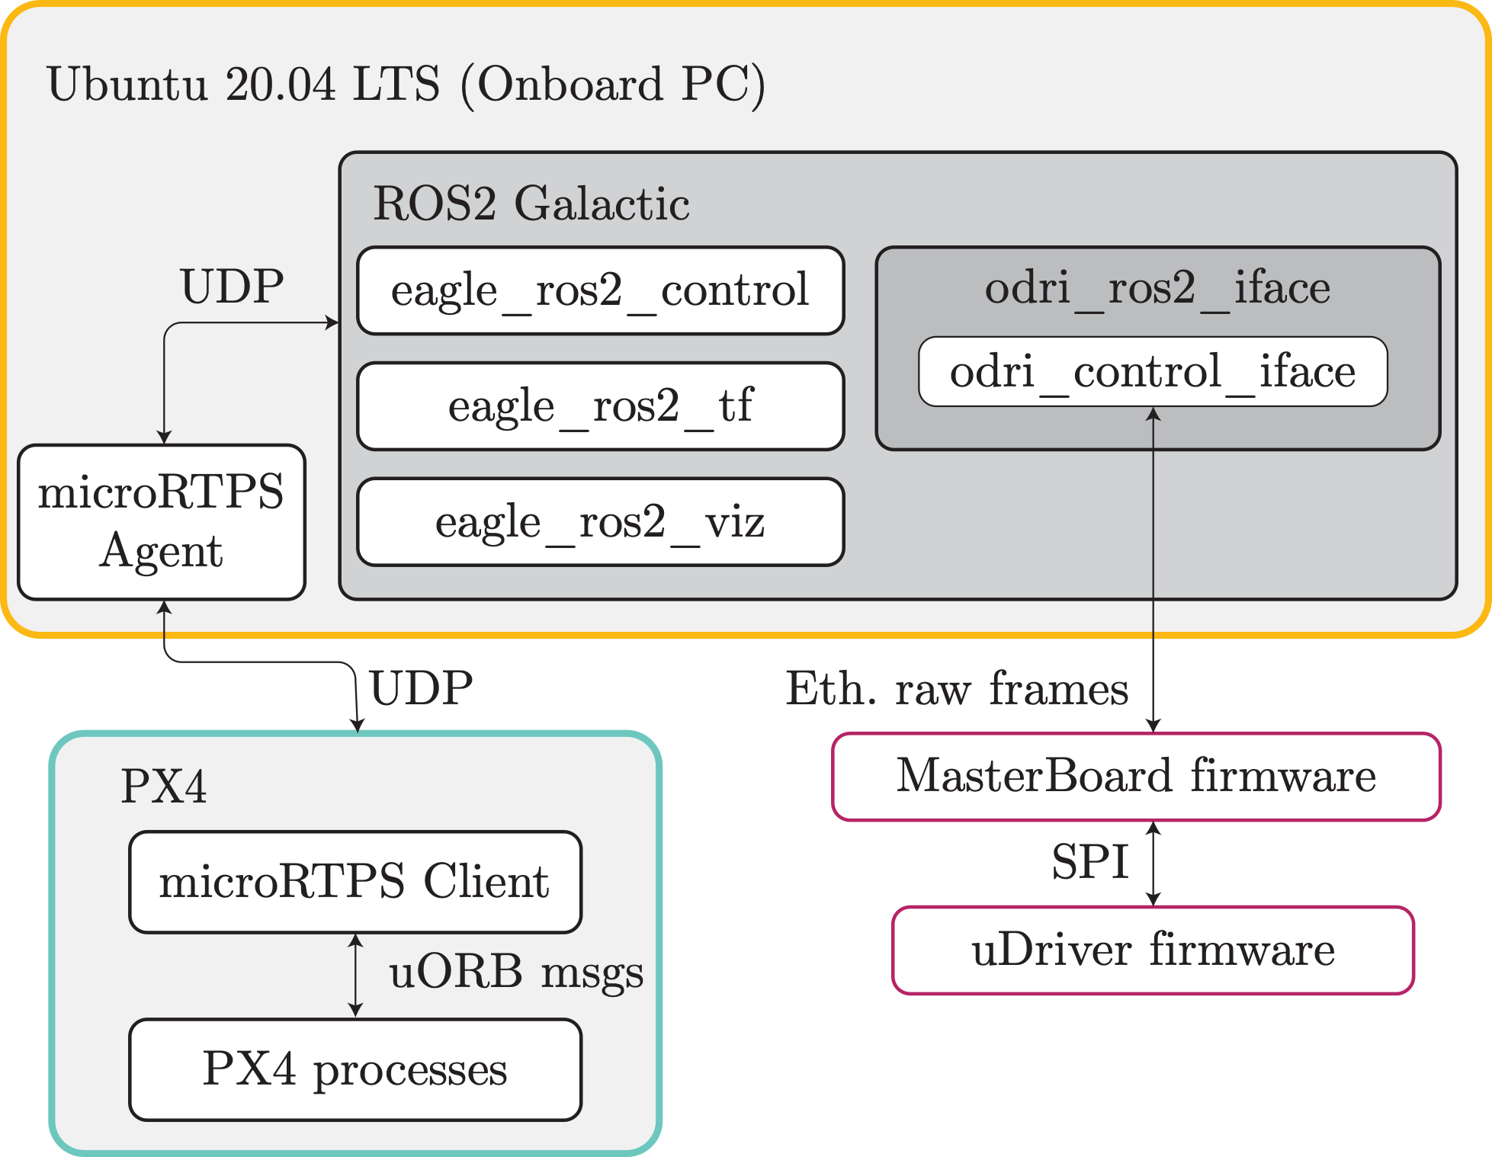
Borinot’s Software

Slide 9
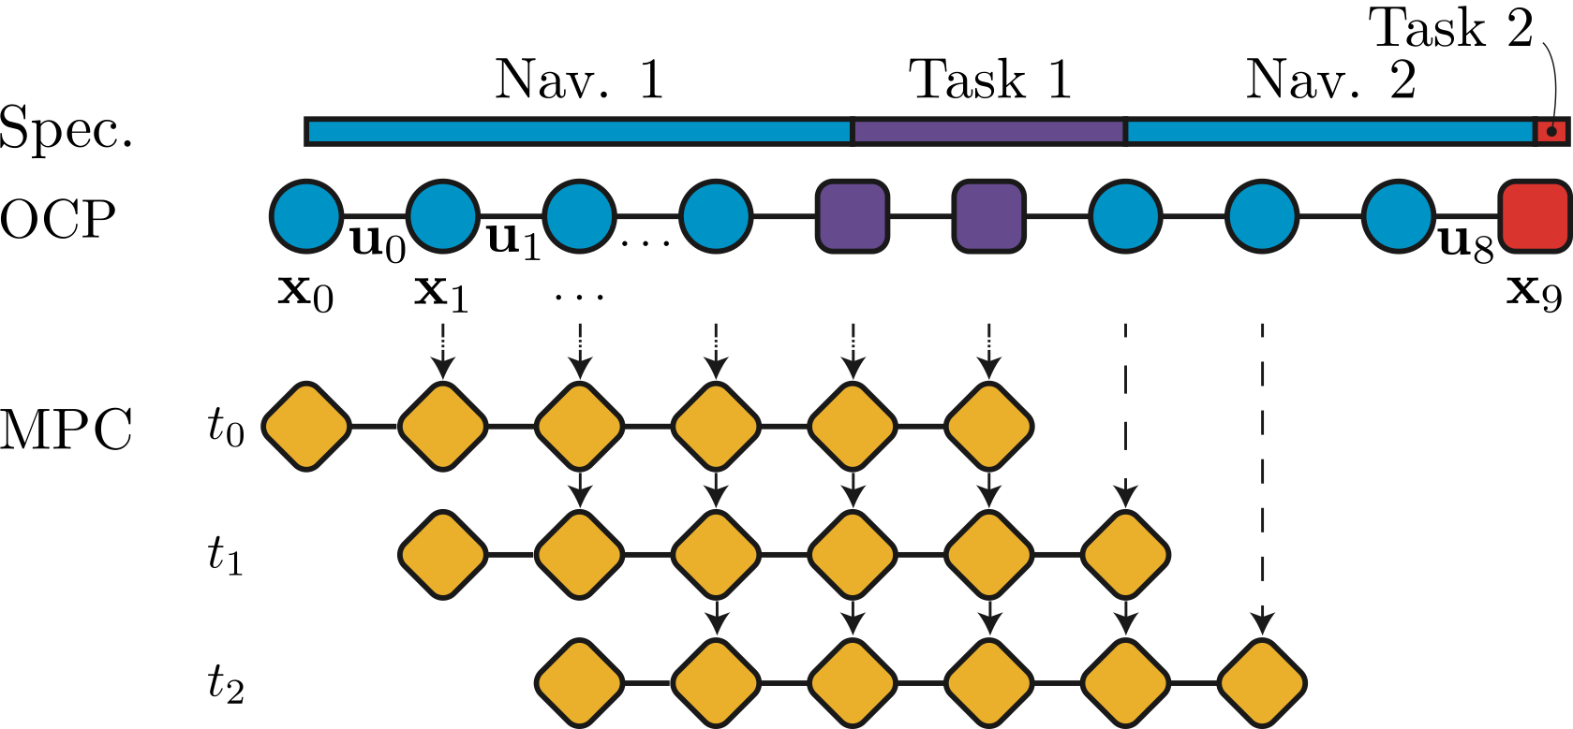
Model Predictive Control
Basic design, very limited features!

Slide 10
Limb as a tail
Static assistance in coronal plane
2,5 seconds
2 seconds

Slide 11
Limb as a tail
Dynamic assistance in sagittal plane
2 seconds
1,8 seconds
1,6 seconds

Slide 12
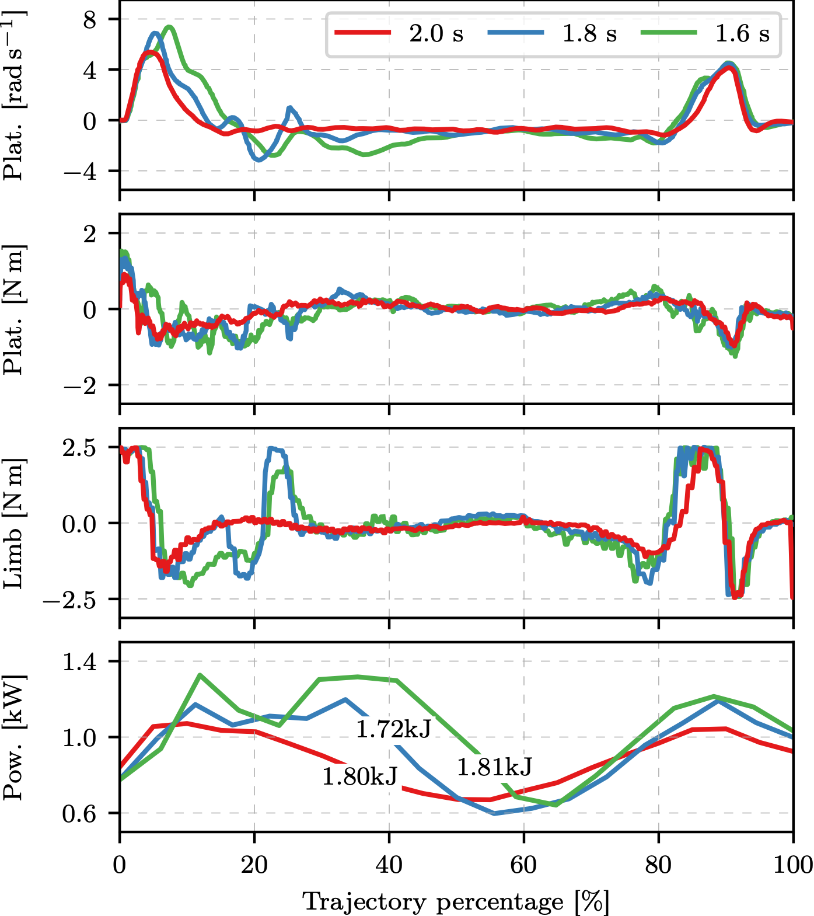
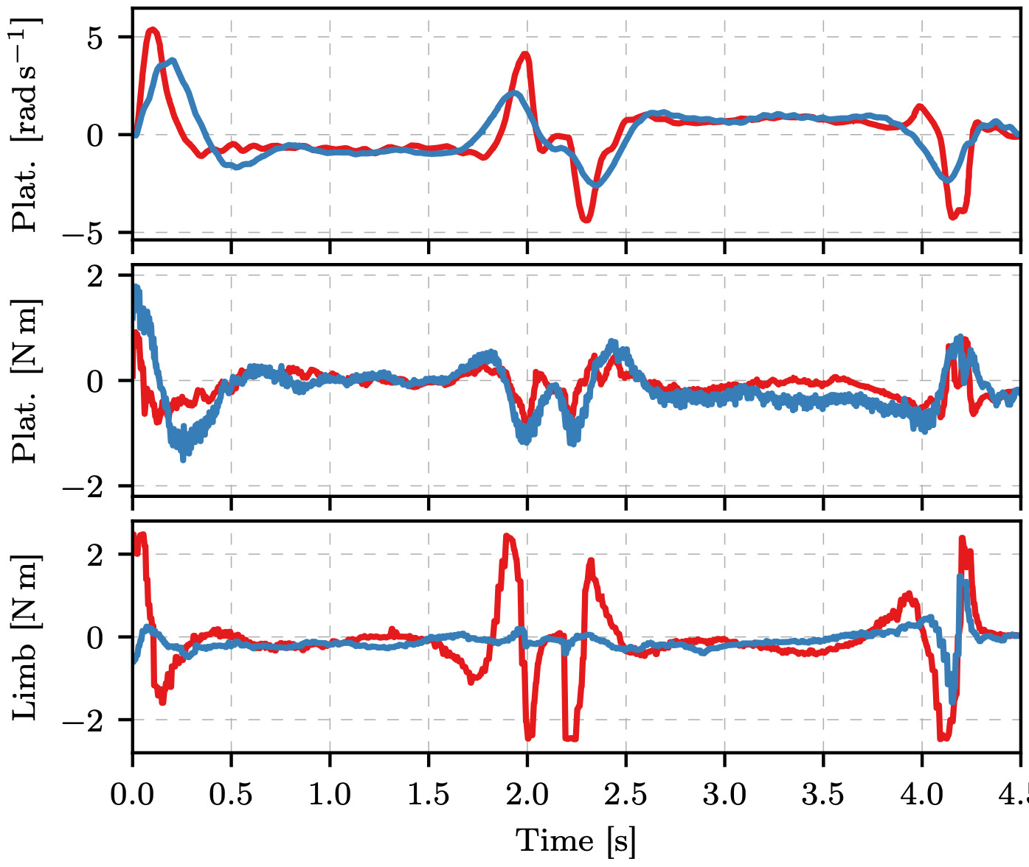
Limb as a tail
Static and Dynamic assistances
Dynamic at different speeds
Static vs. Dynamic

Slide 13
Limb as an arm
Dynamic aerial manipulation

Slide 14
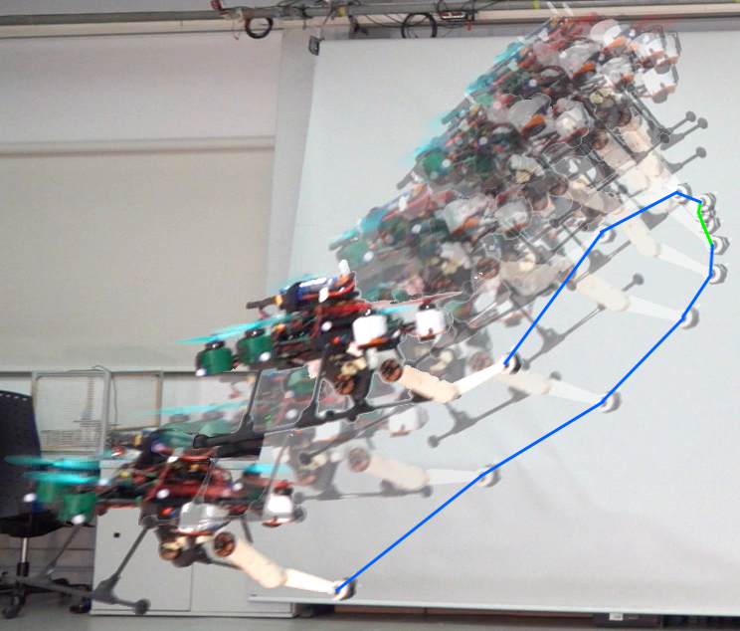
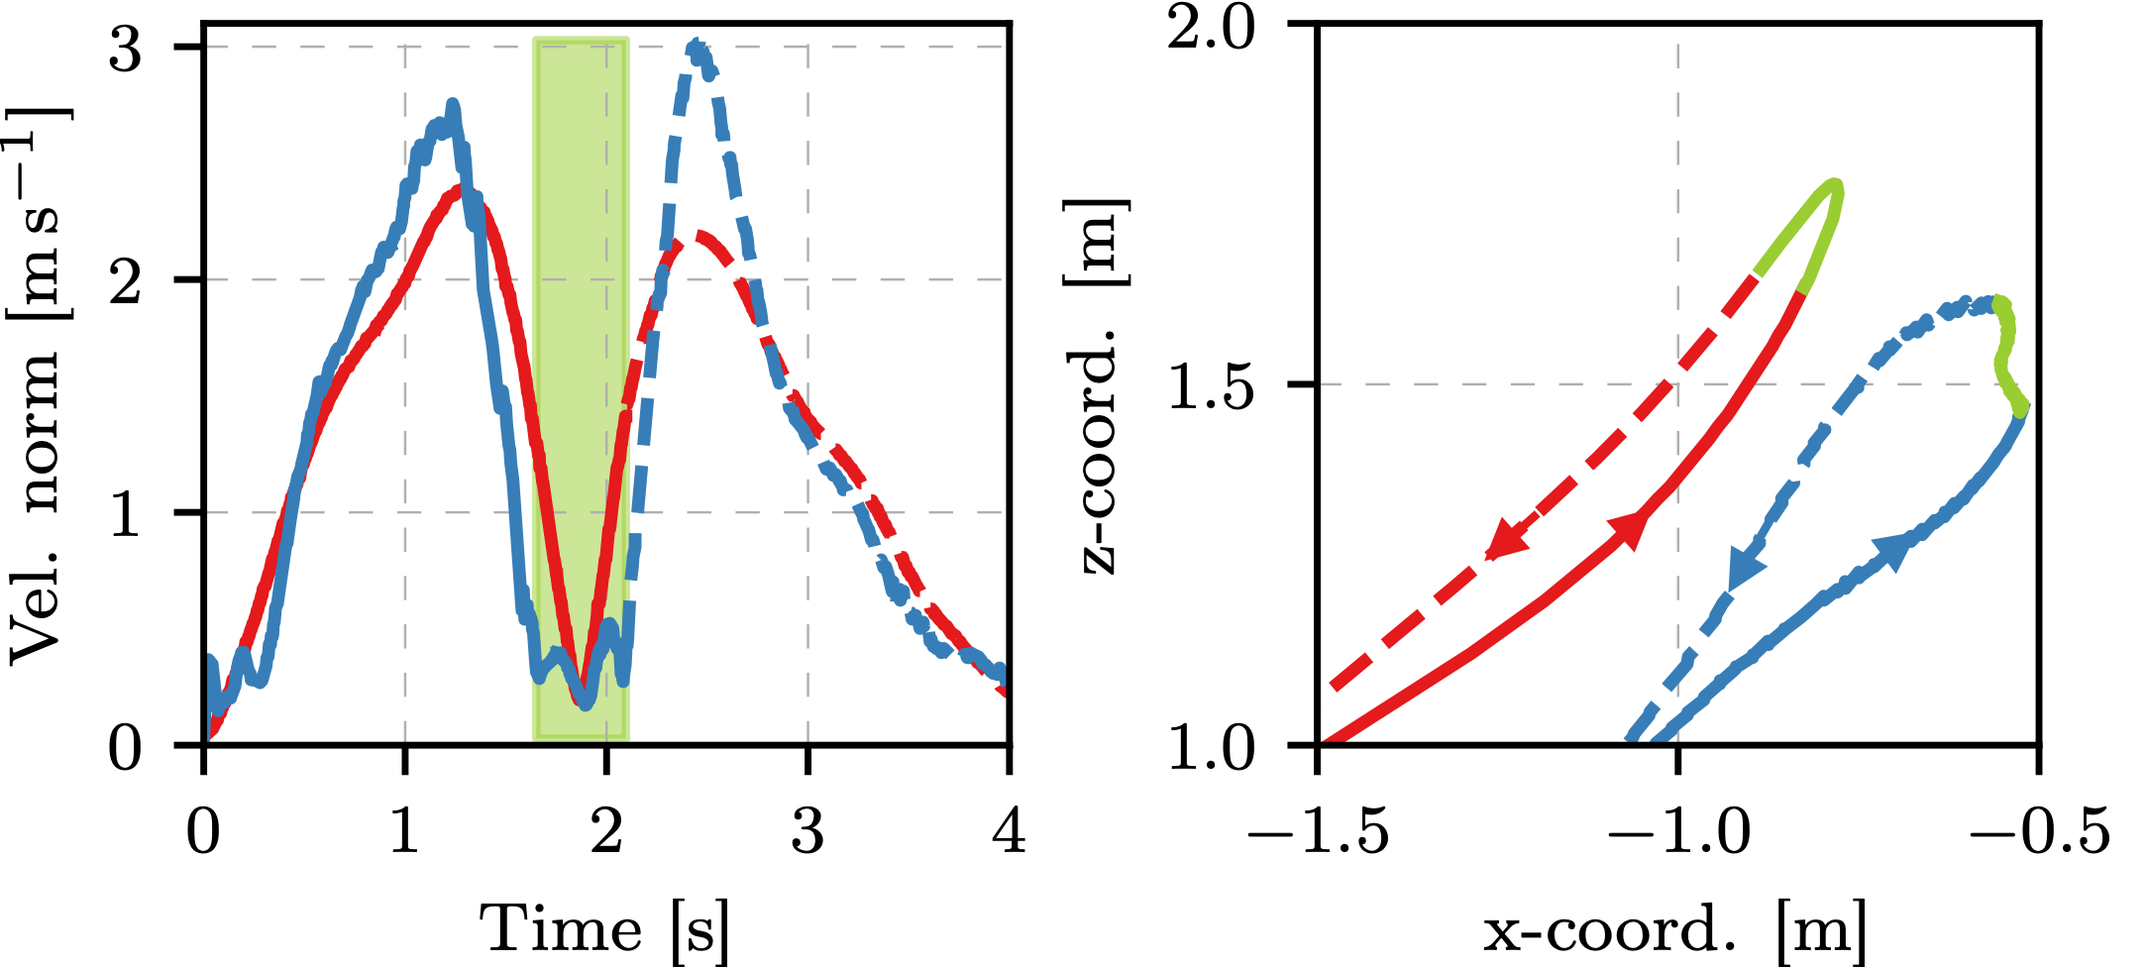
Limb as an arm
Dynamic aerial manipulation

Slide 15
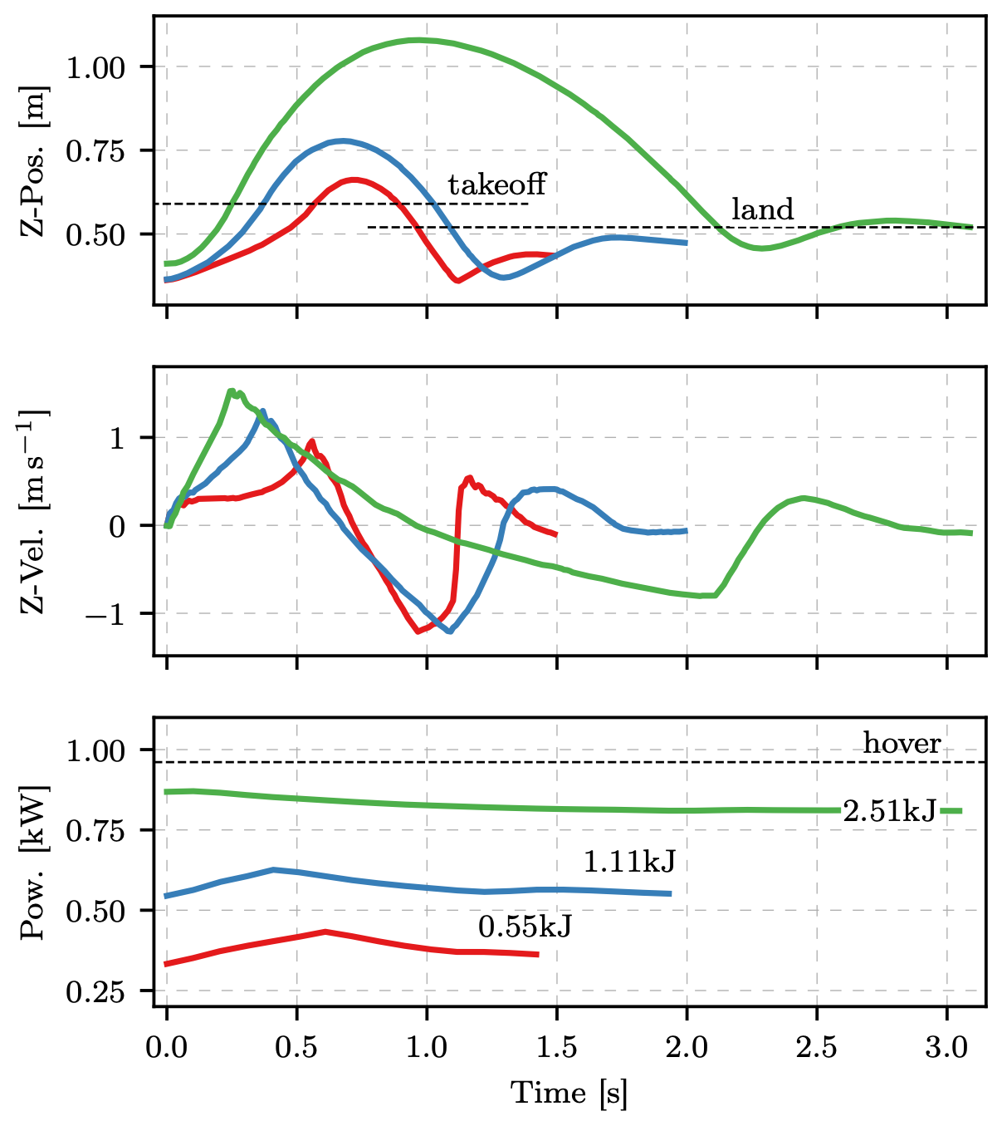
Limb as a leg
Jump-and-flight locomotion

Slide 16
Thank you!

