Slide 1
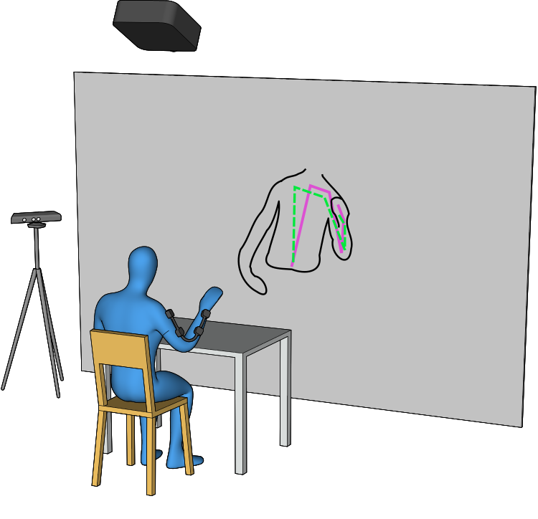
Virtual humanoid twin for impaired movement evaluation Mathilde Lestoille mathilde.lestoille@hest.ethz.ch

Slide 2
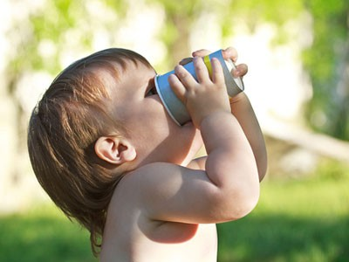
Assessing impaired motions
From IFMK Brest
→ Motor assessment required to follow recovery process
Osborne et al., “Physical Therapist Management of Parkinson Disease: A Clinical Practice Guideline From the American Physical Therapy Association”. In: Physical Therapy 102.4 (2021)
Fugl-Meyer et al., “The post-stroke hemiplegic patient. 1. a method for evaluation of physical performance.” In: Scandinavian journal of rehabilitation medicine (1975)

Slide 3
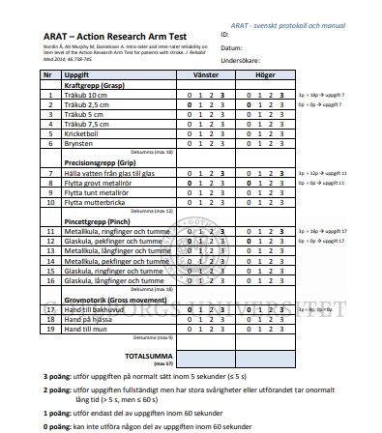
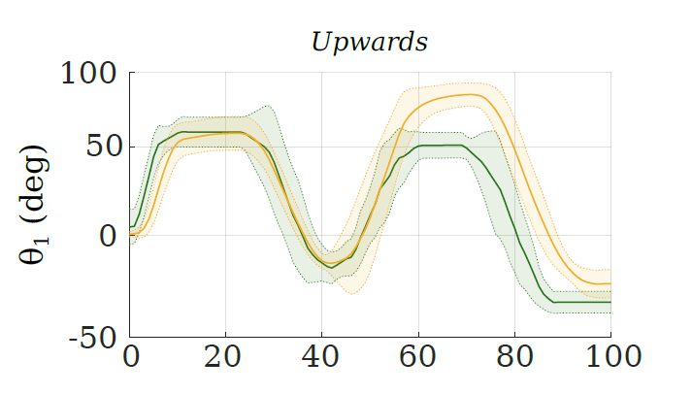
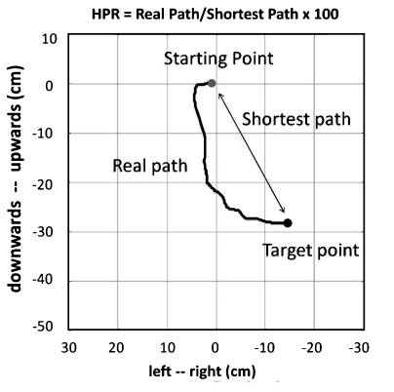
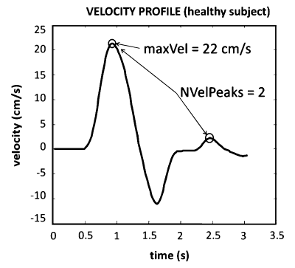
Assessing impaired motions
With the naked eye
Standardized tests
Quantitative metrics
Pierella et al., “A multimodal approach to capture post-stroke temporal dynamics of recovery”. In: Journal of Neural Engineering (2020)
Poole and Whitney. "Assessments of motor function post stroke: A review." Physical & Occupational Therapy in Geriatrics 19.2 (2001)

Slide 4
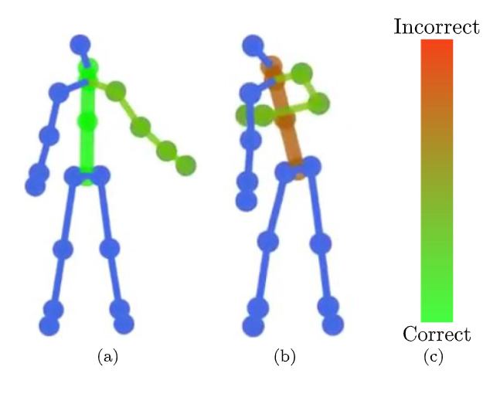
Need for reference data
Motions from healthy subjects
Motions of the unaffected side
- averaged over subjects
- different morphologies
Laterality
Cumbersome
Task-specific
Baptista et al. "Home self-training: Visual feedback for assisting physical activity for stroke survivors." Computer methods and programs in biomedicine 176 (2019)
Nordin, et al., “Assessment of movement quality in robot- assisted upper limb rehabilitation after stroke: a review”. In: Journal of Neuro-Engineering and Rehabilitation (2014)

Slide 5
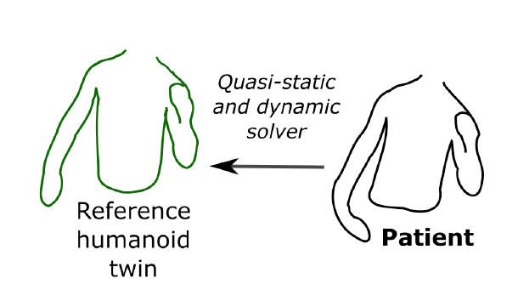
Goal of the project
Generating human-like reference motions with IK
Task independent
Personalized (morphology + abilities)

Slide 6
Definition of the optimization problem
1. Body model
2. Task
3. Cost functions
Upper body only
Kinematic chain with patient’s anatomical attributes
Pelvis fixed
Quasi-static: end-effector placement at each t= patient
Dynamic: final end-effector placement = patient
Minimization of the jerk
Minimization of distance with rest posture
…

Slide 7
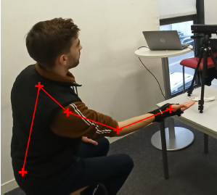
Example I –static implementation
EE placement
15 healthy participants
Without and with motion constraints
9 DOF kinematic chain
3 pelvis rotations
1 scapula elevation
3 shoulder rotations
1 elbow flexion
1 wrist pronosupination
with
Rest posture
Deadzone function
Weights
Solved with null-space reconfiguration
Poignant et al. "Computing the positioning error of an upper-arm robotic prosthesis from the observation of its wearer’s posture." 2021 IEEE International Conference on Robotics and Automation (ICRA). IEEE, 2021

Slide 8
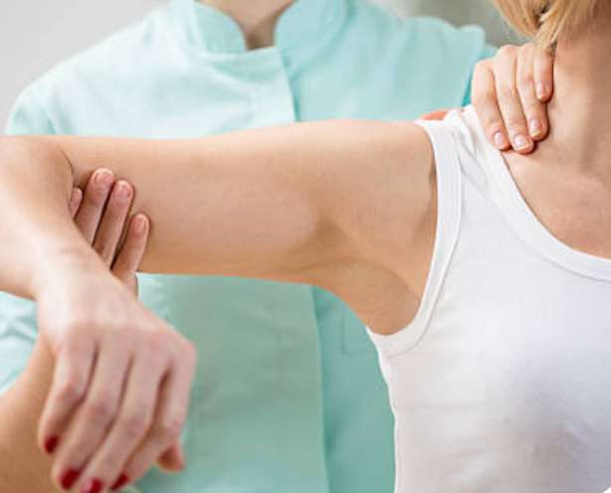
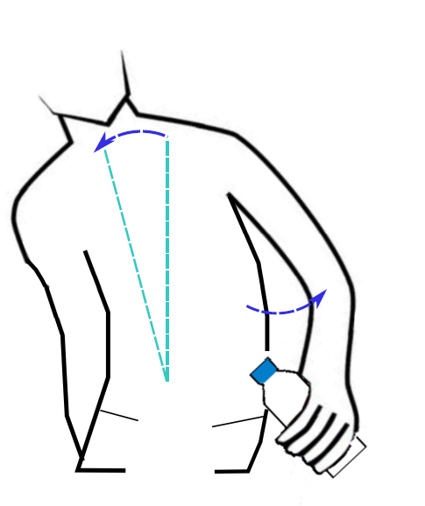
Example II – quasi-static implementation
Real-time visual FB for post-stroke home therapy
Lambercy et al. "Neurorehabilitation from a distance: can intelligent technology support decentralized access to quality therapy?." Frontiers in Robotics and AI 8 (2021)

Slide 9
Example II – quasi-static implementation
Optimization problem
Cost function: minimization of trunk and shoulder displacement
Constraints: EE placement = patient
Inequality constraints for all arm joint angles
11 DOF kinematic chain
3 pelvis rotations
1 scapula elevation
3 shoulder rotations
1 elbow flexion
3 wrist rotations
On-going development, tests with patients scheduled for Fall 2023

Slide 10
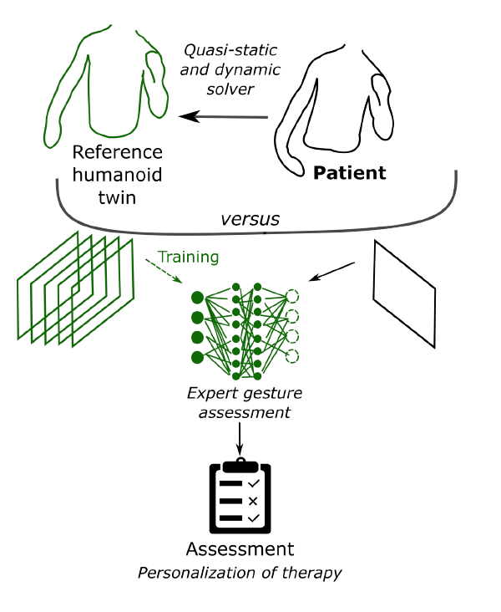
Next steps
Comparison of cost functions / tasks
Proper validation
Dynamic approach
Use for artificial training data

Slide 11
Conclusion
Motion generation with IK for personalized motor assessment, without the need of data collection
First interesting results with simple methods; many possible improvements
Complementary approach: modelling of impaired motion
Many thanks to: Alexis Poignant, Nathanaël Jarrassé, Guillaume Morel, Nicolas Mansard, Vincent Bonnet, Maxime Sabbah, Mohamed Adjel, Roger Gassert, Olivier Lambercy

Slide 12
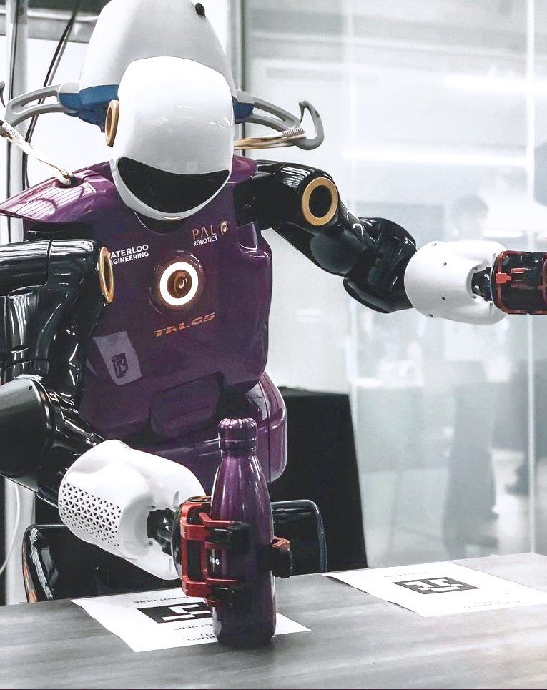
Questions?
Virtual humanoid twin for impaired movement evaluation
Mathilde Lestoille mathilde.lestoille@hest.ethz.ch
Rehabilitation Engineering Laboratory
Gloriastrasse 37/39
8092 Zürich, Switzerland

